Slide 1

^{when the sun rises}
^{we work hard to deliver}
SUBJECT / TOPIC : INSTITUTIONALISATION OF M AND E
Venue: MIDDLEBURG
Date: 23 JULY 2026

Slide 2
PRESENTATION OVERVIEW
What are we addressing in the society? Identifying the root cause.
National government Mandate
Overview of Provincial government Mandate.
Building a culture of accountability.

Slide 3
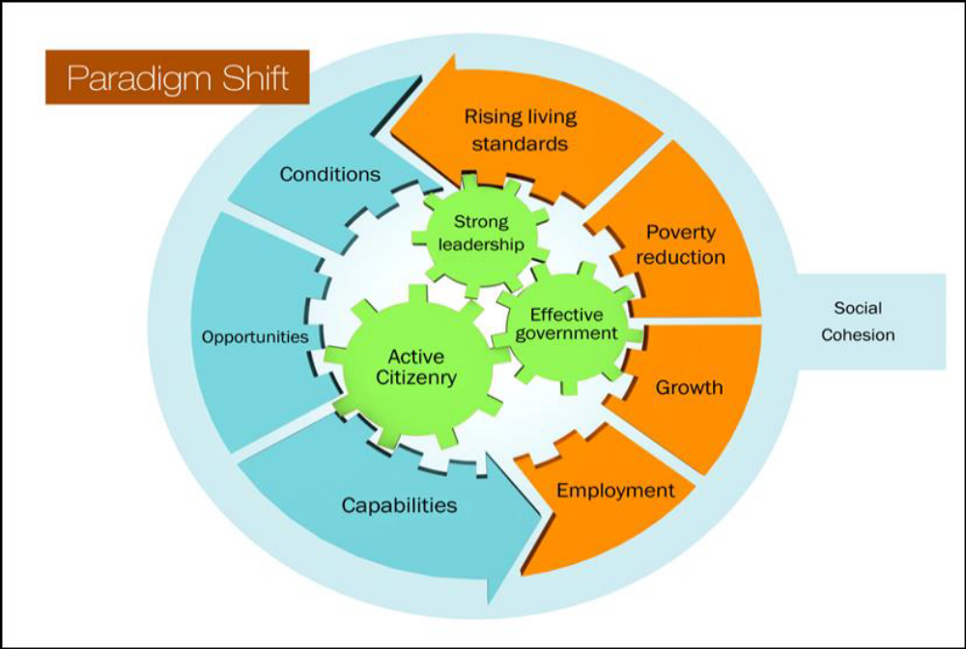
Why do we exist?
Through what strategic models?
Addressing the root cause of Poverty & Vulnerability
What are the lower hanging fruits?
What accountability measures should be in place?

Slide 4
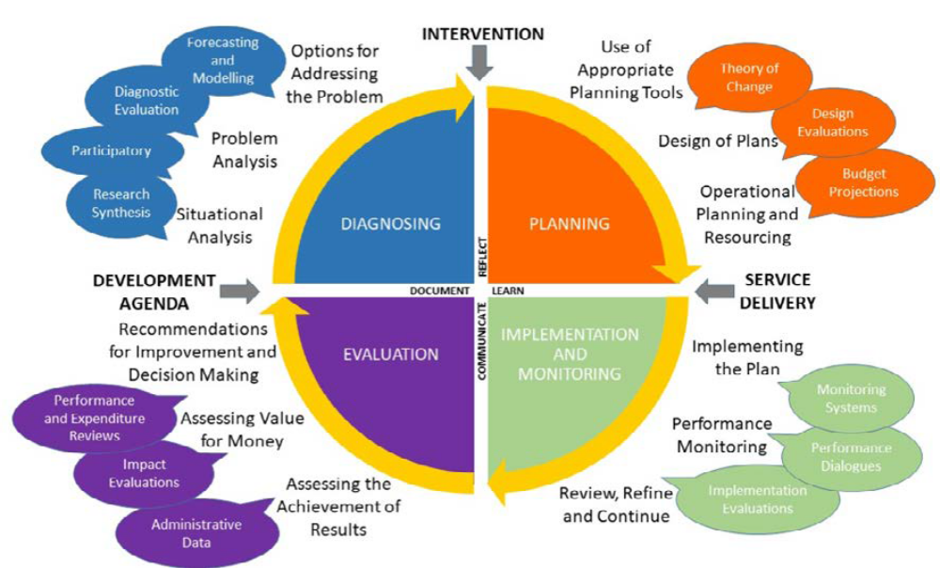
IMPORTANCE OF INTEGRATED PLANNING, MONITORING AND EVALUATION

Slide 5

DPME Mandate
Whole of Government Planning (MTDP)
Long-term planning – strengthening national development planning
Medium- and short-term planning – Co-ordination and institutionalisation of an integrated government planning system.
Evaluating critical government programmes with the intention to inform planning, monitoring and interventions as well as budget prioritisation.
PLANNING
EVALUATION
Integrated Monitoring Framework
Result Chain approach to implementation of the NDP, SDG and AU Agenda 2063
Service delivery oriented and output based monitoring systems backed
by evidence.
Interventions on behalf of
Province and National
MONITORING

Slide 6
The Logical Connection of Custodian Units
Provide strategic leadership w.r.t. planning, advise on key issues for consideration for planning, working with all units to draft plans, assist and assist in getting the plans approved
Organisation (all units)
Strategic Planning
Monitoring and Evaluation
Risk Management
Internal Audit
Have the responsibility to manage their programmes and report periodically on performance. Heads of units must account for the level of performance
Advise on performance, working with all units to improve reporting and performance, Draft Quarter Reports, Reviews and Annual Reports and ensure storage on information. Evaluation information to be used to improve programme performance
Provide assurance on controls and operations of the organisation. Work together with Planning, M&E and risk to provide combined assurance
Advise on risks that organisation is exposed to, conduct periodic risk reviews and work together with the Audit committee and the Executive to manage risks

Slide 7
From Compliance to a culture of accountability
Sustainable culture of accountability
Evidence-based decision-making
Institutionalising M and E at National
Alignment with government programmes NDP
Medium Term Development Plan
Legal and policy mandate
Capacity building

Slide 8
A CULTURE OF ACCOUNTABILITY
Leadership buy in. The centre that holds.
Integration with budget
Development of organisational culture
Development of Planning, Implementation Monitoring and Evaluation culture.
Existing government policies, plans, programmes and projects, and the key output, outcome and impact indicators agreed upon by the policymakers/project teams;
Managers and all stakeholders championing M&E evidence production
Use M and E evidence in decision-making for planning, resource allocation and implementation.

Slide 9

STRATEGY success is dependent on the process and not only the content!
Understanding the business
Business Map;
Definition of what winning looks like;
Alignment of direction & priorities;
Hitting the right opportunities;
Trade off’s;
What and how can we change:

Slide 10
Planning with the end in mind
Decolonise planning, programme implementation, M and E.
Intergovernmental relations and cooperation.
Results Based Management
Citizen/stakeholders involvement in programme planning, implementation, monitoring and evaluation.
Integrated development planning, budgeting, monitoring and evaluation, and performance information systems.
Evidence-based and issue-responsive development plans and public policies.
Plan for evaluations from inception.
Disseminate evaluation reports and annual reports to all stakeholders/citizens to inform progress and impact.
M and E reports that inform policy, resolution of societal problems, inform senior management.

Slide 11
Institutionalising M and E at the provincial level
Planning, monitoring, evaluation and research, pursued as separate activities, tend to generate data without changing decisions.
Learning Monitoring Evaluation Accountability and Planning.
Integrated MTDP
M and E, Research system.
Implementation at provincial and local level guided by the Results Framework.
Roadshows to sensitize all stakeholders on Provincial.
Political appetite FOHOD, and various forums.

Slide 12
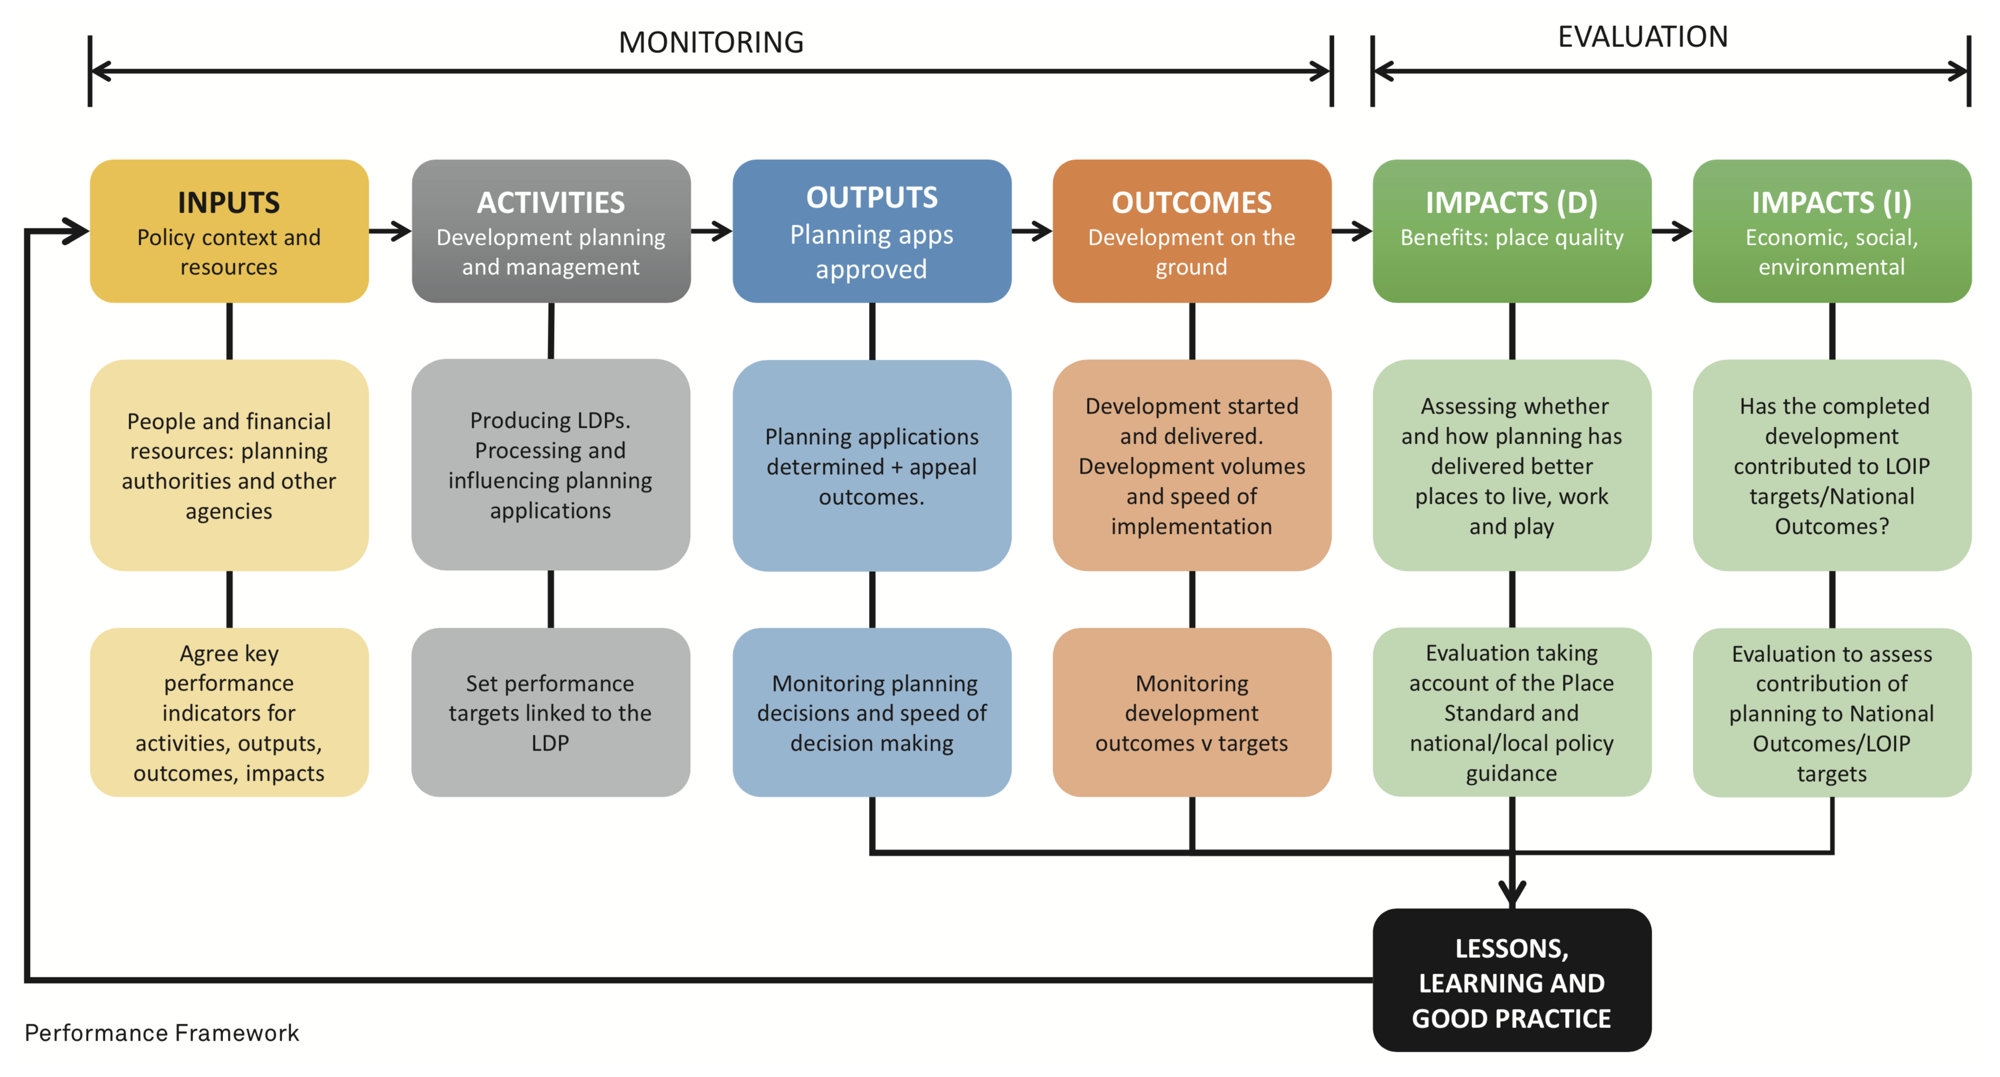
INSTITUTIONALISED M AND E

Slide 13

THANK YOU
DANKIE
REA LEBOHA
HI NKHENSILE
SIYATHOKOZA SIYABONGA
NDOLIVHUAA
ENKOSI

