Slide 1

JUST ENERGY TRANSITION
Project Management Unit
The Mindset Shift: From Compliance to Continuous Monitoring, Evaluation and Learning (MEL)
Provincial Monitoring, Evaluation and Learning Seminar/Workshop
23 July 2026
Christel Jacob
Monitoring, Evaluation & Learning
Manager

Slide 2
THE MINDSET SHIFT: FROM COMPLIANCE TO CONTINUOUS LEARNING
USING THE JET IP MEL FRAMEWORK AS AN ILLUSTRATION
Key Concepts:
1. The Compliance Trap – Why traditional M&E falls short
2. The Learning Paradigm – What continuous learning looks like
3. The JET IP MEL Framework – A case study in action
4. Key Enablers – Making the shift happen
5. Your Journey – Practical next steps

Slide 3
THE COMPLIANCE TRAP
Traditional M&E Mindset
Feature | Outcome
Donor-driven reporting | Meeting external requirements
Fixed indicators | Measuring what's easy, not what matters
Annual reporting cycles | Information arrives too late
Judgement-oriented | Fear of "bad" results
Siloed data | No cross-learning

Slide 4
THE COST OF COMPLIANCE-ONLY M&E
Real Consequences:
Late insights – Annual reports reveal problems that were already visible months ago
Missed opportunities – No mechanism to course-correct
Poor stakeholder engagement – Communities feel like data sources, not partners
Limited learning – No incentives to share failures or innovations
Wasted resources – Data collected but never used for decision-making

Slide 5
THE LEARNING PARADIGM
From Compliance to Continuous Learning
Traditional M&E | Learning-Oriented MEL
Fixed plans | Adaptive and emergent
Annual reporting | Real-time feedback loops
Top-down indicators | Co-created with stakeholders
Judgement | Improvement and adaptation
Accountability only | Accountability + Learning
Siloed | Integrated across systems

Slide 6
INTRODUCTION TO JET IP
The Just Energy Transition Investment Plan
South Africa's 5-year plan (2023-2027) for a low-carbon, climate-resilient economy
Investment need: R1.5 trillion
Sectors: Electricity, New Energy Vehicles, Green Hydrogen
"Just" component: Ensuring no one is left behind
Partners: International partner countries, private sector, civil society

Slide 7
JET M&E Framework Overview
4 Key Components:
1. Theory of Change – Guides MEL alignment – How change happens
2. M&E Framework – Tracks indicators (e.g., RE capacity, jobs) - Indicators and data systems
Impact Indicators (country level) – wider JT impact
Core indicators (register level) – jobs, livelihoods, community engagement, institutional strengthening, emissions
Medium Term Outcome Indicators (PMU level) – changes in behaviour and performance
Short Term Outcome indicators (PMU level) – changes in capacity & systems
3. Investments Register – Public database of JET investments - Tracking financial flows
4. Learning System – Evaluations & stakeholder feedback - Feedback loops and adaptation

Slide 8
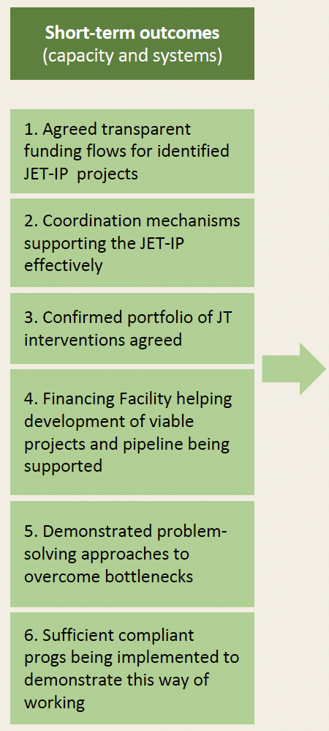
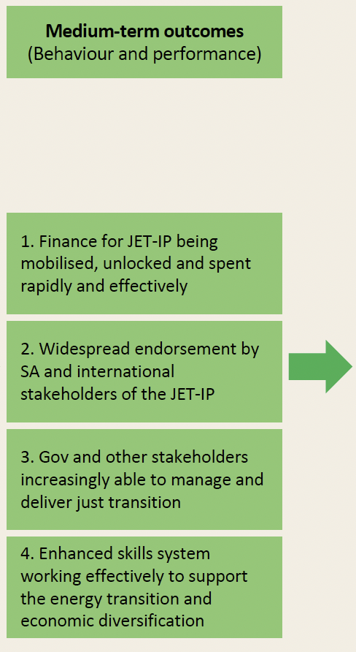
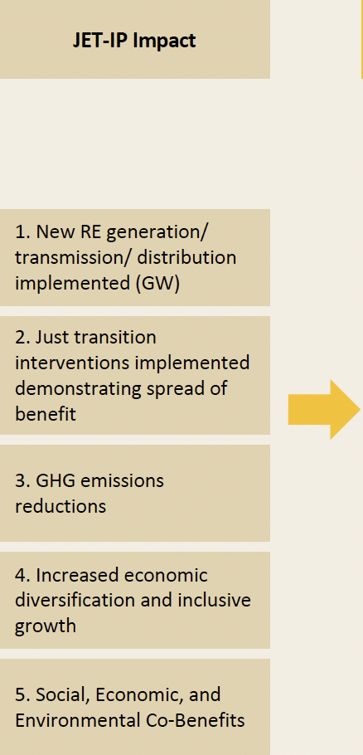
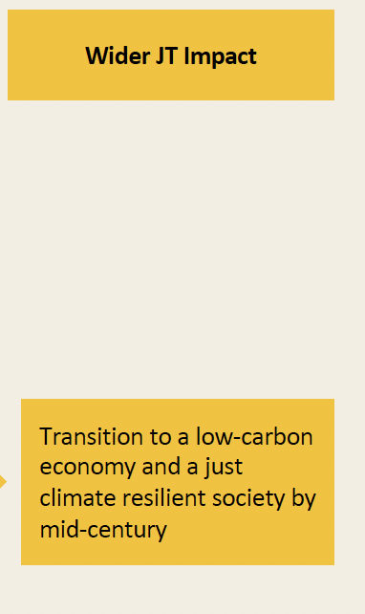
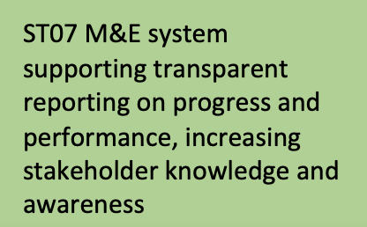
Theory of Change (ToC) for JET IP
Monitoring, Evaluation and Learning
Developing impact milestones StatsSA
Developing internally STO/MTO, milestones
Community engagement
Jobs +
Livelihoods
Emissions reductions
Core indicators
Institutional strengthening
6 portfolios – electricity, NEVs, GH2, muni distribution, skills, Mpumalanga JT (note each need M&E system)

Slide 9
M&E FRAMEWORK
Tracking Progress and Impact
Indicators: Impact, outcome, and output indicators
Data Sources: Established(ing) baselines and data collection systems
Reporting: Quarterly reports on outputs and outcomes
Evaluations: Annual impact assessments, major evaluation in 2026
Participatory Monitoring: Communities involved in tracking progress

Slide 10
INVESTMENTS REGISTER
Tracking Financial Flows
Purpose: Track how funds are mobilised and used
Sources: International partners, private sector, government
Principles: Fiscal sustainability, appropriate risk sharing
Transparency: Publicly accessible reporting
https://justenergytransition.co.za/jet-investment-register-dashboard

Slide 11
THE LEARNING SYSTEM
The "L" in MEL: What Makes It Different
Problem-solving orientation: M&E exists to improve decision-making
Emergent approach: Systems adapt as new information emerges
Feedback loops: Real-time information flows from implementation to decision-makers
Learning agenda: Key questions identified for ongoing inquiry
Evaluative studies: Both rapid studies and in-depth evaluations
Public reporting: Transparency builds trust and enables broader learning

Slide 12
MINDSET SHIFT IN ACTION
What This Looks Like Practically
Traditional M&E Question | JET IP MEL Question
Did we spend the budget? | Are we making progress toward a just transition?
Did we deliver the outputs? | What outcomes are we achieving and for whom?
Did we meet our targets? | Why are we (or aren't we) achieving our targets?
What did we do? | What are we learning and what should we change?

Slide 13
KEY ENABLER 1 STAKEHOLDER PARTICIPATION
Moving from "Data Source" to "Learning Partner“
Collaborative design: Stakeholders co-create indicators and milestones
Participatory monitoring: Communities track progress in their own contexts
Procedural justice: Ensuring affected communities have a voice
Trust-building: Transparency creates space for honest learning

Slide 14
KEY ENABLER 2 - INTEGRATED SYSTEMS
Breaking Down Silos
Government coordination: Aligned Theories of Change across departments
Shared indicators: Common metrics enable comparison
M&E Working Group: Coordinates efforts across portfolios
Complementary systems: Build on existing tracking efforts

Slide 15
KEY ENABLER 3 - EMERGENT ADAPTATION
Planning for Uncertainty
Not everything can be predicted: Plans must evolve
Signal tracking: Use milestones to detect transformational shifts
Speed and scale: Monitor these critical dimensions
Evaluative thinking: Build curiosity and inquiry into daily practice

Slide 16
KEY ENABLER 4 - LEADERSHIP AND CULTURE
The Human Element
Leadership commitment: Leaders must model learning
Psychological safety: It's safe to share failures and challenges
Learning culture: Inquiry is valued over certainty
Capacity building: People need skills for evaluative thinking

Slide 17
LESSONS FROM THE JET IP MEL JOURNEY
What We're Learning So Far
1. MEL systems for complex problems must be emergent (evolving)
2. The "just" dimension requires participatory approaches
3. Data infrastructure takes time to build
4. Feedback loops must be intentional, not accidental
5. Attribution is challenging - focus on contribution

Slide 18
BRINGING IT TO YOUR CONTEXT
Questions for Reflection
1. Where is your organization in the compliance-learning spectrum?
2. What would it take to shift toward a more learning-oriented approach?
3. How can you create more space for stakeholder participation?
4. What feedback loops would help you adapt more quickly?
5. How can leaders model a learning mindset?

Slide 19
YOUR LEARNING JOURNEY
Practical Next Steps
Immediate | Short-term | Long-term
Conduct a MEL maturity assessment | Develop a learning agenda | Build a culture of evaluative thinking
Identify one learning question for your team | Design feedback loops | Integrate MEL into governance
Share this presentation with colleagues | Pilot participatory approaches | Share learning publicly

Slide 20
CLOSING
The Mindset Shift: Key Takeaways
Compliance asks: Did we do what we said?
Learning asks: Are we making a difference and how can we improve?
The JET IP MEL Framework shows that it's possible to build systems that serve both purposes.
The shift begins with you.

Slide 21
Appendix:
JET IP MEL Key Resources
JET IP M&E Framework
JET IP Investments Register
Quarterly Reports
Evaluative Studies (2026-2028)
Web: www.justenergytransition.co.za

