Slide 1

National Evaluation Policy Framework (NEPF) 2025 & Implementation Plan
23 July 2026

Slide 2
Outline
Why NEPF?
Applicable legislations and policy foundations
Rationale for revising the NEPF
NEPF 2025 Development process
Objectives of NEPF 2025 and strategic focus
Types of evaluation
Evaluation criteria
Undertaking evaluations in government
Development of evaluation plans
Institutionalisation, governance, and capacity
NEPF implementation and review
Recommendations

Slide 3

WHY THE NEPF?
Is the intervention properly designed, clear objectives, theory of change?
Is implementation effective?
Is it having the desired impact?
The NEPF sets government-wide evaluation standards, thereby institutionalising a culture of evaluation as a tool for public policy management.
The primary purposes of evaluation in government: Improve performance (learning); Strengthen accountability; Generate knowledge (research); and Inform decision-making.
The NEPF articulates the founding mandate of the DPME, as custodian of the national evaluation system, in building the system and ensuring coordination of the actors and instruments.
In this way, NEPF positions evaluation as a strategic tool in the effort to build a capable, ethical and developmental state.
Knowledge about what works and what does not with regards to policies, programmes, functions, projects or organisations.
Generating
Knowledge
(Learning)
Performance
Improving
Decision
Making
Accountability
Should changes be made to the intervention?
Should it be continued, scaled-up or terminated?
Should the budget be increased?
Feedback to programme managers, policymakers and citizens:
Where is public spending going?
Is the spending making a difference?

Slide 4
APPLICABLE LEGISLATION AND POLICY FOUNDATIONS
FOUNDATIONAL LAWS
Constitution (1996):
  Upholds human dignity, equality, non-racialism, non-sexism, rule of law, and democratic accountability.
  Section 195: Promotes efficiency, transparency, accountability, and a development-oriented public service.
Public Finance Management Act (PFMA, 1999):
  Requires effective, efficient, economical, and transparent use of resources; establishes systems for evaluation.
Public Service Act (1994):
  Provides for performance-oriented, accountable governance.
Municipal Finance Management Act (MFMA, 2003):
  Extends evaluation and accountability principles to the local government sphere.
SUPPORTING POLICY FRAMEWORKS
Government-Wide M&E Framework (2007): Foundation for institutionalising evaluation through FMPPI, SASQAF, and NEPF.
Proclamation No. 43 of 2014: Established DPME to integrate planning, monitoring, and evaluation in the Presidency.
GRPBMEA (2019): Embeds gender, youth, and disability inclusion in planning and evaluation.
SEIAS (2015), FSAPP (2019), NPDF (2020): Link evaluation with planning, budgeting, and policy development.
INTERNATIONAL & REGIONAL ALIGNMENT
UN Resolution A/RES/77/283 (2023): Strengthens national evaluation systems for SDGs.
Addis Ababa Declaration (AU & AfrEA): Promotes Africa-led, inclusive, innovative, and sustainably financed evaluation systems.

Slide 5
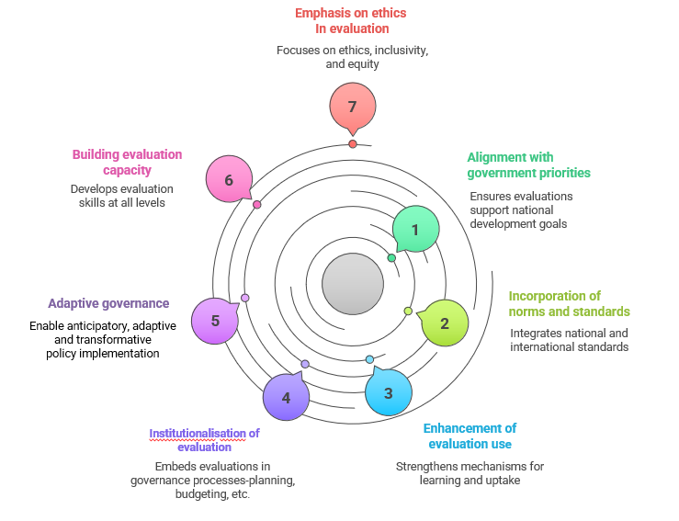
RATIONALE FOR REVISION OF THE NEPF
The national evaluation policy must adapt to several important contextual shifts:
The review is timeous, to ensure that the NEPF remains relevant and fit for purpose – mainly to incorporate the new knowledge in the field of evaluation and align with the evolving national priorities (i.e., MTDP 2024-2029 priorities of 7th Administration).
There is urgency to accelerate implementation and results, given the development backlog and the period remaining towards the 2030 targets of the National Development Plan (NDP) and the Sustainable Development Goals (SDGs).
Governance in GNU/coalition arrangements demands greater transparency among partners and towards citizens. Evaluation must reinforce evidence-informed decision-making for setting priorities, allocating resources, and managing performance across all spheres of government.
Amid rising uncertainty and interconnected crises, evaluations must support adaptive governance through systems thinking, real-time feedback, and foresight tools to guide policy choices and adjustments in improving service delivery.

Slide 6
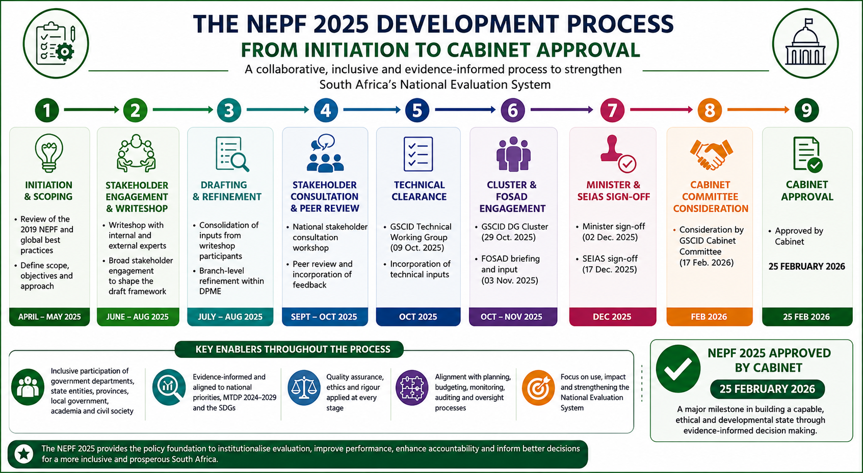

Slide 7
Objectives of NEPF 2025 and strategic focus
The Objectives of the NEPF 2025 are to:
Improve development outcomes through the institutionalisation of evaluative practices across government
Ensure evaluation evidence actively informs planning, budgeting, and oversight
Promote inclusive, equitable, and climate-sensitive policy making
Strengthen the national evaluation capacity and professionalisation; and
Support adaptive governance and policy innovation across the government and wider society.
These objectives will be achieved through the following strategic focus and thrusts:
Supporting the use of diverse evaluative approaches across the policy and programme cycle;
Enhanced utilisation focus to improve performance and impact of public interventions;
Embracing digital and data innovations;
Fostering collaborative arrangements and partnerships; and
Supporting adaptive and transformative governance.

Slide 8
TYPES OF EVALUATION AND THEIR APPLICABILITY
Throughout policy life-cycle:
Synthesis Evaluations
Problem identification:
Diagnostic Evaluations
Aggregates existing
evidence and
generates policy
recommendations
Identifies challenges
and their root
causes
Policy review:
Impact Evaluations
Policy formulation and planning
Design Evaluations
Assesses long-
term effects on the target population
Assesses the robustness
and relevance of policy/ programme designs
Policy Implementation:
Economic Evaluations
Policy Implementation:
Implementation Evaluations
Evaluates cost-
effectiveness, including
gender-responsive
budgeting
Reviews and improves
the implementation
process
Policy implementation:
Outcome Evaluations
Determines if intended outcomes are being achieved

Slide 9
EVALUATION CRITERIA
Developed by the OECD Development Assistance Committee (1st in 1991 and last updated in 2019):
Relevance
Is the intervention doing the right thing?
Coherence
How well does the intervention fit?
Effectiveness
Is the intervention achieving its objectives?
Efficiency
How well are resources being used?
Impact
What difference does the intervention make?
Sustainability
Will the benefits last?
Development by South Africa (1st in 2023)
Climate Ecosystem Health (CEH)
How does the intervention contribute to CEH; and how it might be affected by changes in CEH?
Transformative Equity (TE)
How does the intervention address systematic inequities?

Slide 10
PROCESS FOR IDENTIFYING EVALUATIONS
Consultatitions with governance
& oversight structures:
Consideration by Evaluation Advisory Committee (EAC):
The Evaluation Advisory Committee (EAC) will apply the selection criteria and make recommendations on the prioritisation of evaluations for the NEP.
Approval:
DPME submits the Draft NEP for approval by Cabinet through the GSCID Cluster and the FOSAD.
Needs analysis
DPME desktop analysis to identify evaluation evidence needs based on, among other things, Cabinet deliberations, cluster priorities, monitoring reports, concerns of citizens, etc. and screen for feasibility and necessity in consultation with affected departments.
DPME consultation with the Governance State Capabilities and Institutional Development (GSCID) Cluster, the Forum of South African Directors-General, the affected national departments and the Parliamentary Portfolio Committee on Planning, Monitoring and Evaluation..

Slide 11
CRITERIA FOR SELECTION AND PRIORITISATION OF EVALUATIONS
Evaluation for the National Evaluation Plan will be prioritised based on the following criteria:
Criteria | Description
Strategic alignment: | Must directly support the MTDP 2024–2029.
Public expenditure significance: | Focus on programmes or policies with substantial fiscal implications (e.g., >R500 million annual spend).
Evidence gaps and policy innovation: | Addresses critical knowledge gaps where no recent evaluations exist
 | Support policy reforms where new evidence is required
 | Offer scope for innovation and learning potential, especially where a programme is testing a new approach or influencing large-scale reforms that require scalability assessment
Risk and complexity: | Focus on high-risk and politically sensitive or high-profile programmes affecting public trust and service delivery.
 | Include multi-sector or inter-departmental programmes requiring coordinated interventions across government clusters and/or multiple departments.
Transformative change and inclusion: | Focus on systems-level transformational change and address cross-cutting issues such as climate change, societal and global shifts, and SDG commitments, including significant impact on women, youth, and persons with disabilities.

Slide 12
INSTITUTIONALISATION, GOVERNANCE AND CAPACITY
Department of Planning, Monitoring and Evaluation
Centre of government
The Presidency
National Treasury
Department of Public Service and Administration
Department of Cooperative Governance
Department of Women, Youth and Persons with Disabilities
Chapter 9 Institutions
Auditor General South Africa
Public Service Commission
Departments and Public Entities
Offices of the Premier
Parliament and Provincial Legislature
Academia
Civil Society
NEPF implementation should be embedded in the work programmes of the Governance, State Capabilities and Institutional Development (GSCID) Cluster and the Forum of South African Directors-General (FOSAD).
DPME – sets policy framework and leads implementation and oversees the functioning of the national evaluation system.
Centre-of-Government departments – provide strategic alignment.
Offices of the Premier and Mayor – drive evaluation in provinces and local government.
Implementing departments – generates programme performance data, conduct some evaluations and use evaluation results.
Chapter 9 oversight institutions – leverage oversight and follow-through within the accountability ecosystem
Partnerships and collaborations – strengthen capacity and share lessons.

Slide 13
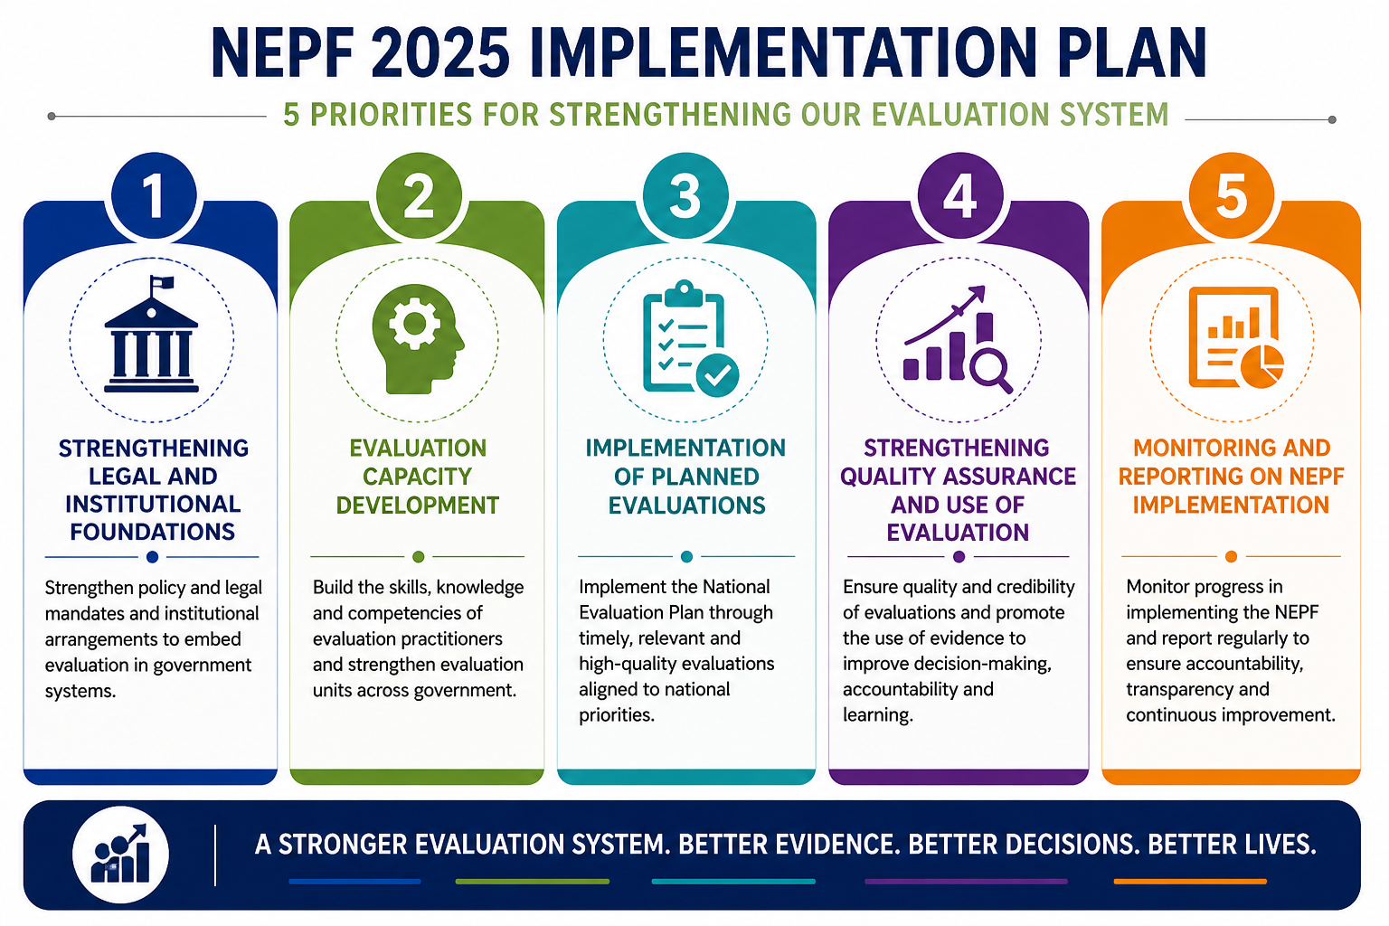

Slide 14
IMPLEMENTATION PLAN FOR THE NEPF 2025
ACTIVITY | TIMELINE | LEADING INSTITUTION | SUPPORTING INSTITUTIONS
PRIORITY 1: STRENGTHENING LEGAL AND INSTITUTIONAL FOUNDATIONS
1.1 Publish the NEPF 2025 and create awareness | 2026 | DPME | SAMEA
1.2 Integrate NEPF principles into the process of the White Paper on Planning, Monitoring and Evaluation | 2026 | DPME
1.3 Develop and/or update evaluation plans to align with NEPF 2025
National Evaluation Plan (NEP) | 2026 | DPME | EAC, GSCID Cluster and FOSAD
Evaluation plans in provinces, sector departments, municipalities | 2026 | Sector departments, offices of the premier, SOEs, municipalities | DPME

Slide 15
PRIORITY 2: EVALUATION CAPACITY DEVELOPMENT
2.1 Develop a National Evaluation Capacity Building Plan | Q1 2026 | DPME | SAMEA, NSG
Replenishment of capacity for evaluation across government | Ongoing | DPME, sector departments, provinces, SOEs
Updating of curriculum for evaluation training courses | 2026–2028 | NSG and academic institutions | DPME
Implementation of learning forums (e.g., Communities of practice (CoPs), brown bag lunch sessions, national evaluation seminar | Quarterly and biannually | DPME | SAMEA, NSG, Universities
Implementation of a competency framework and certification pathways | 2026 | SAMEA | DPME, DPSA, NSG

Slide 16
PRIORITY 3: IMPLEMENTATION OF PLANNED EVALUATIONS
3.1 Secure budgets to support execution of planned evaluation projects | Annually | DPME and sector departments, | National Treasury
3.2 Implement planned evaluations | 2026 ongoing | DPME, sector departments, provinces, SOEs | NSG, all spheres of government, & development partners
3.3 Establish/Maintain partnerships to support NEPF implementation | 2026 ongoing | DPME | NSG, all spheres of government & development partners
3.4 Implementation of Improvement Plans | 2026 onward | Sector departments and DPME | Parliament, PSC

Slide 17
PRIORITY 4: STRENGTHENING QUALITY ASSURANCE AND USE OF EVALUATION
4.1 Update evaluation guidelines to align with NEPF 2025 (e.g. Outcome evaluation, Institutional Reviews, etc.) | 2025 (in progress) | DPME | DPME, Partners, Departments and EAC
4.2 Maintain quality assurance mechanisms (steering committees, peer reviews, stakeholder validation, etc.) | 2026 onward | DPME, sector departments, evaluators
4.3 Maintain a DPME Evaluation Portal to share evaluation reports and other tools | 2026 onwards | DPME
4.4 Develop interactive knowledge-sharing products (policy briefs, infographics and summaries) for public dissemination | 2026 onwards | DPME | Custodian departments

Slide 18
PRIORITY 5: MONITORING AND REPORTING ON NEPF IMPLEMENTATION
5.1 Produce an annual report on NEPF implementation and publish | 2026 onwards | DPME | Sector Departments

Slide 19

THANK YOU

