Slide 1


PROVINCIAL EVALUATION SEMINAR
Using Evaluation to Strengthen Programme Design, Planning, Implementation and Results
From Evidence to Better Public Value
Dr Lesedi Senamele Matlala, PhD
Chairperson, South African Monitoring and Evaluation Association (SAMEA)
Senior Lecturer, School of Public Management, Governance and Public Policy | University of Johannesburg
Nkangala District Municipality, Mpumalanga • 23 July 2026
Notes:
Good morning, colleagues. It is an honour to join you today. Evaluation has become one of the most powerful governance tools available to governments worldwide—not simply because it measures performance, but because it enables governments to learn, adapt and make better decisions. Today, I would like to demonstrate how evaluation can strengthen every stage of the policy and programme cycle, from programme design through implementation to achieving meaningful outcomes and long-term impact.

Slide 2

Why Evaluation Matters More Than Ever
Governments are under increasing pressure to demonstrate that public investments produce meaningful and measurable results.
KEY DRIVERS
“
1
Growing fiscal constraints and increasing demand for public accountability.
Evaluation bridges the gap between public expenditure and public value by providing credible evidence on what works, for whom, under what conditions, and why.
2
Rising expectations for evidence-informed policymaking and decision-making.
3
Persistent socio-economic challenges despite significant public expenditure.
4
Greater emphasis on achieving sustainable development outcomes and public value.
5
Increasing complexity of public sector programmes requiring adaptive learning and continuous improvement.
2
Notes:
Public resources are increasingly limited, making value for money a governance imperative. Governments are expected to justify not only how funds are spent, but whether they improve citizens' lives. Many programmes continue despite limited evidence of effectiveness, highlighting the need for systematic evaluation. Evaluation supports learning, accountability, transparency, and adaptive management throughout the programme lifecycle. Ultimately, evaluation transforms evidence into better decisions, stronger programmes, and improved public outcomes.

Slide 3
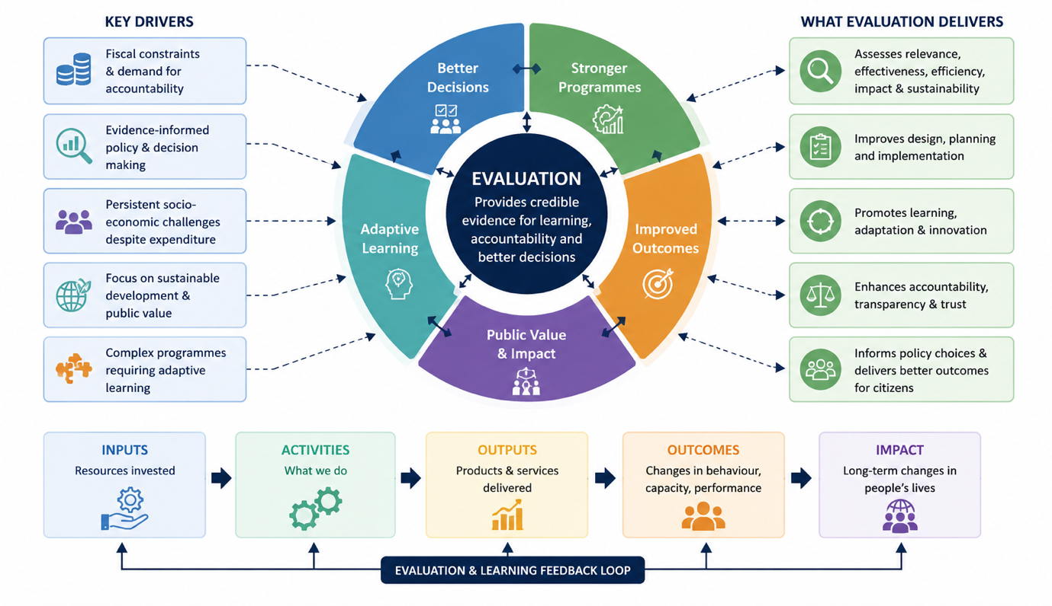
Why Evaluation Matters More Than Ever…..
Continued…
“
Evaluation is the engine of the results chain — turning inputs into activities, outputs, outcomes, and lasting impact, while continuously feeding evidence back into better decisions, stronger programmes, and public value.
2
Notes:
This diagram brings together everything we've discussed today. On the left are the drivers pushing evaluation onto the governance agenda — fiscal pressure, the demand for evidence-informed decisions, and increasingly complex programmes. At the centre, evaluation provides the credible evidence that powers five interconnected benefits: better decisions, stronger programmes, improved outcomes, public value, and adaptive learning — notice these aren't a straight line, they reinforce each other continuously. On the right, we see what evaluation delivers in practice: assessing relevance and effectiveness, improving design and implementation, promoting learning, and strengthening accountability. And at the bottom is the results chain itself — inputs, activities, outputs, outcomes, impact — with evaluation running underneath as the feedback loop, not something bolted on at the end. The takeaway is simple: evaluation isn't a compliance exercise sitting outside government; it's the engine that turns investment into public value.

Slide 4
The Global Evolution of Evaluation
From Measuring Performance to Transforming Governance
KEY MESSAGES
Evaluation has evolved alongside public sector governance, responding to increasingly complex policy and development challenges.
1
The focus has progressively shifted from measuring compliance and performance to supporting evidence-informed decision-making, organisational learning, and adaptive governance.
2
Today, evaluation is recognised as a strategic governance function that strengthens accountability, innovation, resilience and sustainable public value across the entire policy and programme cycle.
3
Did we deliver? → How can we continuously improve outcomes and create lasting public value?
3
Notes:
Evaluation has not stood still — it has evolved in step with public sector governance itself, responding to increasingly complex policy and development challenges over the decades. What started as a compliance-driven exercise — checking whether money was spent as planned — has progressively shifted toward something far more strategic: supporting evidence-informed decision-making, organisational learning, and adaptive governance. Today, evaluation is recognised globally as a strategic governance function, one that strengthens accountability, drives innovation, builds resilience, and creates sustainable public value across the entire policy and programme cycle. In short, the question has changed. Governments used to ask, "Did we deliver?" Now the more important question is, "How can we continuously improve outcomes and create lasting public value?" That shift — from counting delivery to driving improvement — is really the story of where evaluation has been, and where it's going.

Slide 5
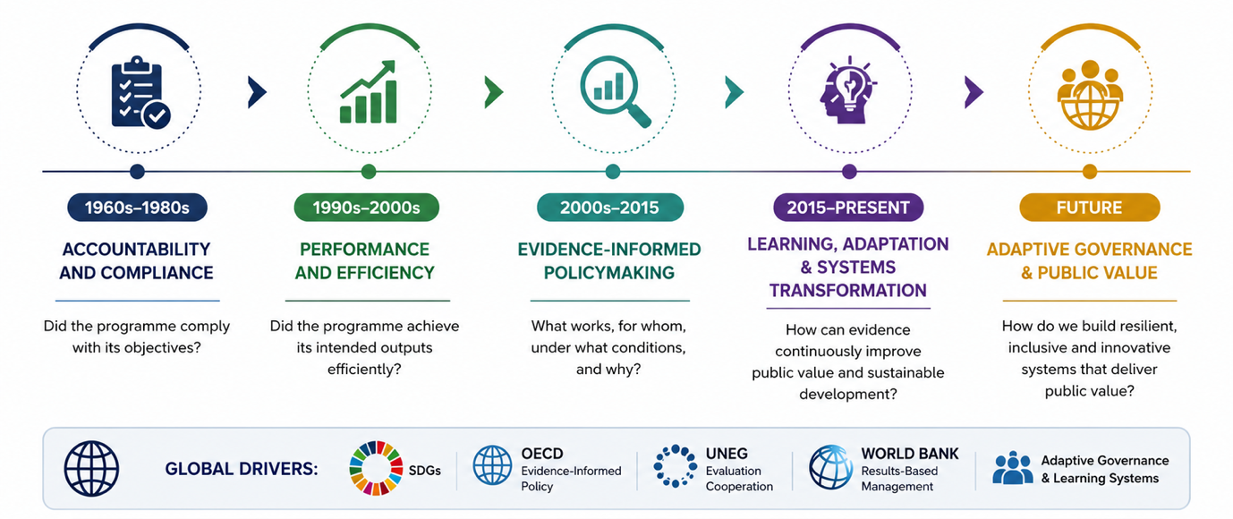
The Global Evolution of Evaluation
Continued….
The evolution of evaluation reflects a fundamental shift from asking “Did we deliver?” to asking “How can we continuously improve outcomes and create lasting public value?”
3
Notes:
Evaluation has not stood still — it has evolved in step with public sector governance itself, responding to increasingly complex policy and development challenges over the decades. What started as a compliance-driven exercise — checking whether money was spent as planned — has progressively shifted toward something far more strategic: supporting evidence-informed decision-making, organisational learning, and adaptive governance. Today, evaluation is recognised globally as a strategic governance function, one that strengthens accountability, drives innovation, builds resilience, and creates sustainable public value across the entire policy and programme cycle. In short, the question has changed. Governments used to ask, "Did we deliver?" Now the more important question is, "How can we continuously improve outcomes and create lasting public value?" That shift — from counting delivery to driving improvement — is really the story of where evaluation has been, and where it's going.

Slide 6
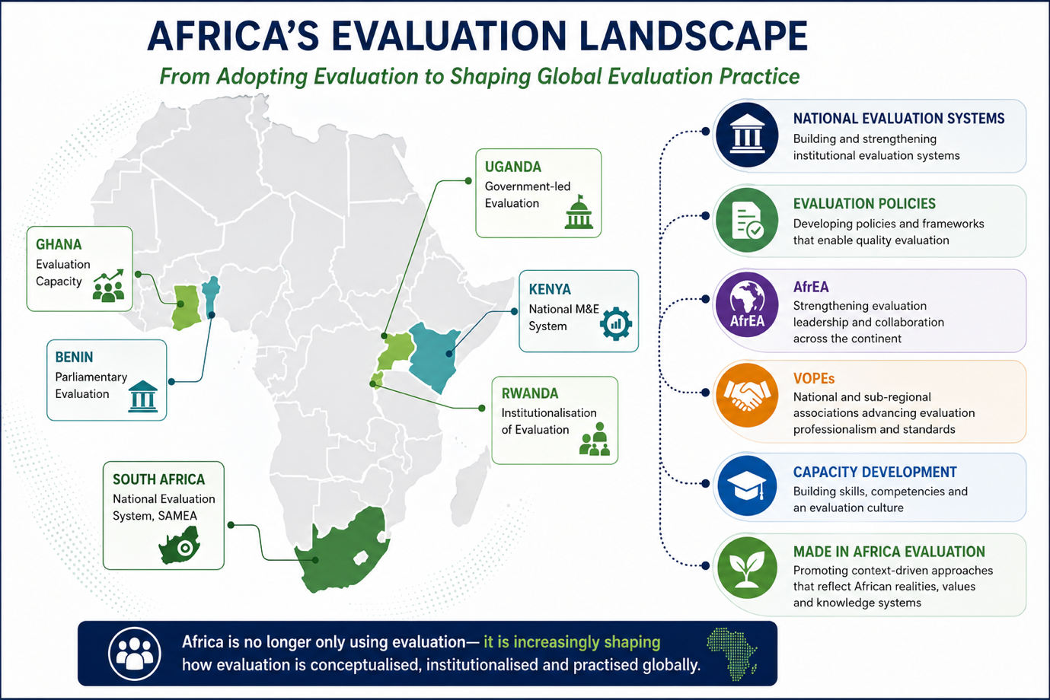
Africa’s Evaluation Landscape
From Adopting Evaluation to Shaping Global Evaluation Practice
AFRICA’S EVALUATION JOURNEY
Evaluation has become an important pillar of good governance, accountability and evidence-informed policymaking across the continent.
African countries are increasingly institutionalising National Evaluation Systems (NES) to improve public sector performance and development outcomes.
Regional collaboration has strengthened evaluation capacity through AfrEA, VOPEs, universities and governments.
Africa has also contributed new perspectives through the Made in Africa Evaluation (MAE) approach, emphasising context, indigenous knowledge and locally relevant evidence.
Africa is no longer only using evaluation — it is increasingly shaping how evaluation is conceptualised, institutionalised and practised globally.
4
Notes:
Over the past two decades, Africa has made significant progress in institutionalising evaluation. Governments are moving beyond donor-driven evaluations towards nationally owned evaluation systems. Organisations such as AfrEA, CLEAR-AA, SAMEA and national VOPEs have played an important role in building professional evaluation capacity. South Africa remains one of the continent's leaders, particularly through its National Evaluation System and the Revised National Evaluation Policy Framework. The continent has also contributed intellectually through the Made in Africa Evaluation movement, recognising that evaluation approaches should reflect African governance systems, cultures and development priorities.

Slide 7
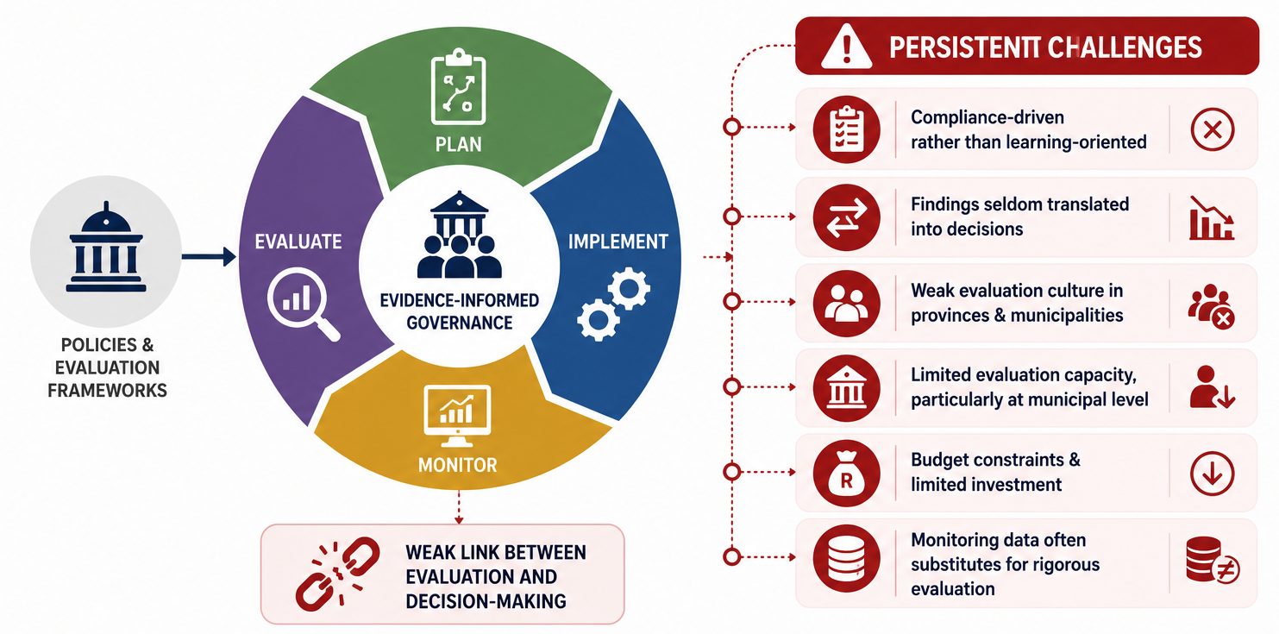
Institutionalising Evaluation in Provincial and Municipal Government
Progress Has Been Significant, but Institutionalisation Remains Uneven
⚠ HOWEVER, SIGNIFICANT GAPS REMAIN
Many municipalities have strong monitoring systems but very limited evaluation capacity.
Evaluation findings are often produced too late, poorly disseminated, or not integrated into planning and budgeting cycles.
Monitoring is frequently confused with evaluation, weakening the evidence base for decision-making.
✓ SOUTH AFRICA’S PROGRESS
South Africa has established one of Africa’s most advanced National Evaluation Systems, supported by the National Evaluation Policy Framework, provincial evaluation plans and growing institutional capacity. Increasingly, provinces and municipalities recognise evaluation as an important component of governance and evidence-informed decision-making.
5
Notes:
South Africa has built an impressive evaluation architecture over the past decade.
The question is no longer whether evaluations are conducted; rather, whether they influence decisions.
Many municipalities have strong monitoring systems but very limited evaluation capacity.
Evaluation findings are often underutilised because they are produced too late, insufficiently disseminated, or not integrated into planning and budgeting cycles.
Another challenge is the tendency to confuse monitoring with evaluation, leading organisations to believe that performance reports alone provide sufficient evidence for decision-making.
Institutionalisation should therefore focus on building an evaluation culture in which managers routinely ask: What worked? What did not? Why? What should we do differently?

Slide 8
Evaluation Across the Programme Lifecycle
Mpumalanga’s Development Challenge: Where Should Evaluation Create Greater Value?
Design
→
Planning
→
Implementation
→
Results
DEVELOPMENT REALITY
Although Mpumalanga has strengthened its institutional evaluation architecture, several provincial and district development indicators continue to suggest implementation and results gaps that require stronger evaluative learning.
KEY MESSAGE
The real measure of evaluation is not the number of evaluations completed — it is the extent to which evaluations change decisions, improve programmes and accelerate development outcomes.
6

Slide 9
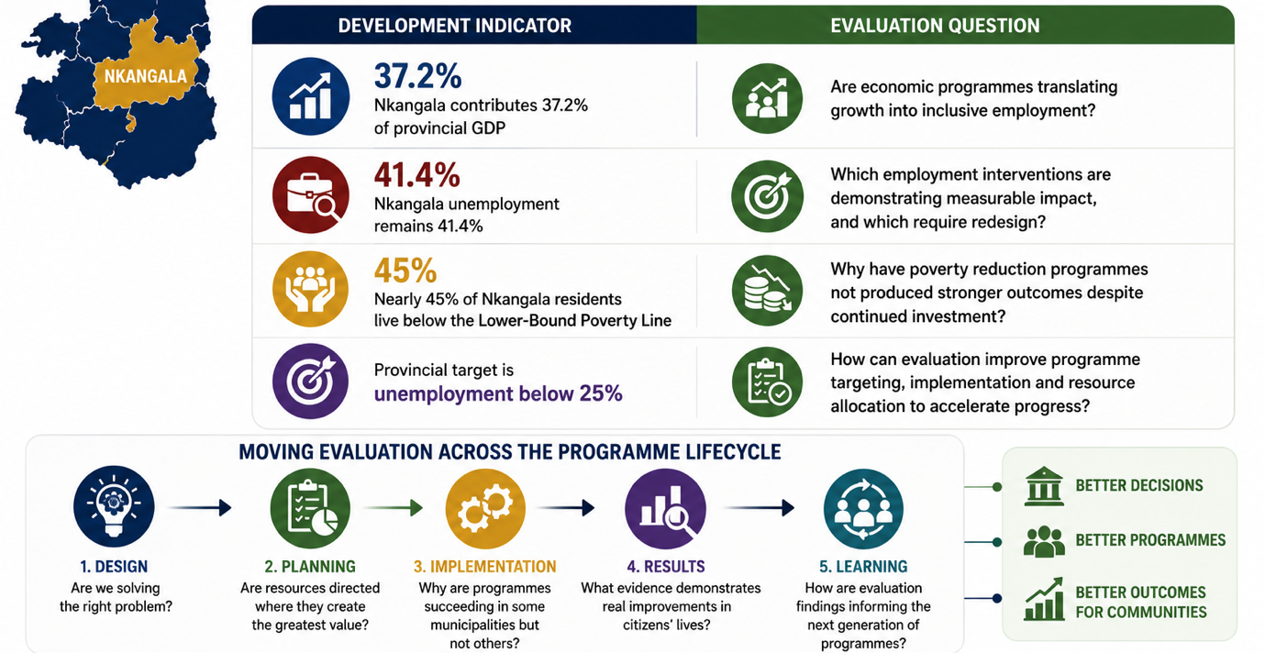
Evaluation Across the Programme Lifecycle
Continued…
KEY MESSAGE
Nkangala's development indicators reveal where evaluation must create greater value — and the programme lifecycle shows how to get there, from design through to learning.
6
Notes:
Let's ground this in Nkangala's own numbers. Nkangala contributes 37.2% of Mpumalanga's provincial GDP, yet unemployment remains at 41.4%, and nearly 45% of residents live below the lower-bound poverty line — against a provincial target of below 25%. These figures alone don't tell us what to do; that's where evaluation comes in. For each indicator, there's a corresponding evaluation question: Are economic programmes actually translating growth into inclusive employment? Which employment interventions are demonstrating measurable impact, and which need redesign? Why haven't poverty reduction programmes produced stronger outcomes despite continued investment? And how can evaluation improve targeting, implementation and resource allocation to accelerate progress? These questions only get answered if evaluation is embedded across the full programme lifecycle — from design, asking whether we're solving the right problem, through planning, implementation, results, and learning, which feeds straight back into the next generation of programmes. Done well, that lifecycle approach doesn't just produce reports — it produces better decisions, stronger programmes, and better outcomes for the communities of Nkangala.

Slide 10
Strengthening Programme Design Through Evaluation
The Cost of Poor Programme Design
Many implementation failures are not implementation problems — they are programme design problems. Evaluation strengthens programme design by:
🔍
Diagnosing the real problem
👥
Understanding beneficiaries
🎯
Testing assumptions
Identifies root causes rather than symptoms.
Ensures interventions respond to citizens’ actual needs.
Validates the Theory of Change before implementation.
⚖
Prioritising resources
📊
Defining measurable outcomes
🔄
Managing implementation risks
Directs investment towards interventions with the greatest potential impact.
Establishes realistic indicators and success criteria.
Identifies barriers before programmes are rolled out.
7

Slide 11
Strengthening Programme Design Through Evaluation
Critical Reflection: What Should Drive Design?
Too often, government programmes are designed around:
rather than
❌
Available budgets
✅
Evidence of what works
❌
Political priorities
✅
Citizen needs
rather than
❌
Historical practices
✅
Context-specific challenges
8

Slide 12
Evaluation as a Tool for Adaptive Implementation
From Reporting Performance to Improving Performance
TRADITIONAL IMPLEMENTATION
Programme → Implement → Report → Continue
EVALUATION-INFORMED IMPLEMENTATION
Programme → Implement → Evaluate → Learn → Adapt → Improve
HOW EVALUATION IMPROVES IMPLEMENTATION
1
Detects implementation bottlenecks — Identifies delays, governance failures and operational constraints before they become systemic.
2
Supports adaptive management — Enables programme managers to modify interventions based on emerging evidence rather than waiting until completion.
3
Strengthens implementation fidelity — Assesses whether programmes are being implemented as originally designed.
4
Improves resource utilisation — Identifies inefficient activities and supports better allocation of financial and human resources.
5
Supports continuous organisational learning — Creates feedback loops that strengthen future programme implementation.
9

Slide 13
From Outputs to Outcomes and Impact
The True Value of Evaluation Lies Beyond Delivery
Critical Reflection
Many government programmes successfully achieve their output targets, yet fail to produce meaningful outcomes because:
programme assumptions were incorrect;
implementation quality was inconsistent;
interventions did not respond to community needs; or
external contextual factors were ignored.
Evaluation helps explain why this happens and what should change.
GOVERNMENT OFTEN CELEBRATES OUTPUTS…
BUT CITIZENS EXPERIENCE OUTCOMES…
✅
Number of houses built
🏠
Better living conditions
✅
Number of roads resurfaced
🚗
Reduced travel time and improved access
✅
Number of young people trained
💼
Sustainable employment
✅
Number of clinics constructed
❤️
Improved health and wellbeing
✅
Number of SMMEs funded
📈
Increased household income
Citizens do not experience outputs — they experience outcomes. Evaluation ensures that government measures success by the difference it makes in people’s lives, not simply by the activities it completes.
10
Notes:
Outputs are important because they demonstrate delivery, but they are not the final measure of success. Evaluation shifts the focus from counting activities to understanding whether programmes are producing lasting improvements. Provincial departments and municipalities should increasingly report on outcomes and impact, not only on compliance with annual targets. Evaluation therefore becomes the bridge between performance management and public value.

Slide 14
The Future of Evaluation in Provincial and Local Government
From Institutionalising Evaluation to Institutionalising Evaluative Thinking
1
2
3
4
5
Build an Evaluation Culture
Strengthen Evaluation Capacity
Use Evaluation Earlier
Leverage Innovation
Strengthen the Use of Evidence
Make evaluation part of organisational learning, not merely compliance.
Invest in skilled evaluators, commissioners and evidence users across government.
Integrate evaluation into programme design, budgeting and implementation — not only at the end.
Harness AI, big data, geospatial analytics and citizen-generated evidence.
Ensure findings routinely inform planning, budgeting, policy revision and delivery.
Evaluation should move beyond being a technical function to becoming a leadership and governance capability embedded in everyday decision-making.
11

Slide 15
Evaluation does not change governments.
The use of evaluation changes governments.
Let’s Keep the Conversation Going
Dr Lesedi Senamele Matlala, PhD
Chairperson | SAMEA
Senior Lecturer | University of Johannesburg
✉️
Email — available on request
🔗
LinkedIn — Dr Lesedi Senamele Matlala
Thank you for your time and engagement.

