Slide 1

^{when the sun rises}
^{we work hard to deliver}
The Mpumalanga Evaluation Experience (2020–2025)
Successes, Challenges & Lessons Learned
Venue: Nkangala District Municipality, Middelburg
Date: 23 July 2026

Slide 2
Presentation Layout
Purpose of the Presentation
Background and Purpose of a Provincial Evaluation Plan
Context and Purpose of PEP 2020-2025
2020-2025 PEP Evaluation Portfolio
2020-2025 PEP Review
Key Findings
Evaluation Success
Evaluation Challenges
Lessons Learnt
Recommendations for 2026-2030 PEP
Concluding Remarks
PRESENTATION OUTLINE
Slide | 2

Slide 3
1. Purpose of the Presentation
The purpose of this presentation is to:
Share insights from the implementation of the Mpumalanga Provincial Evaluation Plan (PEP) 2020–2025 and strengthen the province’s evaluation culture through:
  Reflecting on successes achieved through evidence-based evaluations.
  Identify challenges encountered during implementation.
  Highlighting lessons learned to inform future evaluation practice.
  Guiding the development of the 2026–2030 Provincial Evaluation Plan.
PRESENTATION OUTLINE
Slide | 3

Slide 4
2. Background & Purpose of the Provincial Evaluation Plan (PEP)
The National Evaluation Policy Framework (NEPF) developed in 2011 by (DPME) & revised in 2019 serves as the guiding document for institutionalizing M&E across government.
Its purpose is to strengthen accountability and improve service delivery by ensuring that decisions are informed by evidence.
The Offices of the Premiers (OTPs) are mandated to develop Provincial Evaluation Plans (PEPs).
Evaluations are approved through consultation with provincial oversight structures and sector stakeholders.
Conducted over a five-year cycle and aligned with:
  Strategic plans
  Provincial priorities
  Budgeting processes
  The broader Medium-Term Development Plan (MTDP)
PRESENTATION OUTLINE
Slide | 4

Slide 5
3. Context and Purpose of PEP 2020-2025
Builds on PEP 2016/17–2018/19, which was the first formal provincial evaluation framework developed in line with the NEPF (supported by GIZ which helped build provincial evaluation capacity).
PEP 2020–2025 was approved in May 2021
Was guided by the National Evaluation Policy Framework (NEPF)
Is aligned to the 2019-2024 Medium-Term Strategic Framework (MTSF) now called 2024-2029 Medium Term Development Plan (MTDP).
Purpose of PEP 2020–2025 to:
  Provide details of evaluations approved by the Provincial EXCO/ Cabinet as priority evaluations to be undertaken over a five-year period
  Advance evidence-based policymaking
  Strengthen service delivery across key sectors
  Emphasize accountability, learning, continuous improvement, and adaptive management
PRESENTATION OUTLINE
Slide | 5

Slide 6
4. 2020-2025 PEP Evaluation Portfolio
Targeted 19 Evaluations but the OTP added the evaluation of the Premier’s Youth Development Fund ( PYDF), resulted to total of 20.
  5 Rapid Evaluations (internal capacity building).
  10 Fully Outsourced Evaluations (external service providers)
  5 Withdrawn Evaluations (due to resource or data constraints).
  Coverage across economic transformation, education, health, and governance.
PRESENTATION OUTLINE
Slide | 6

Slide 7
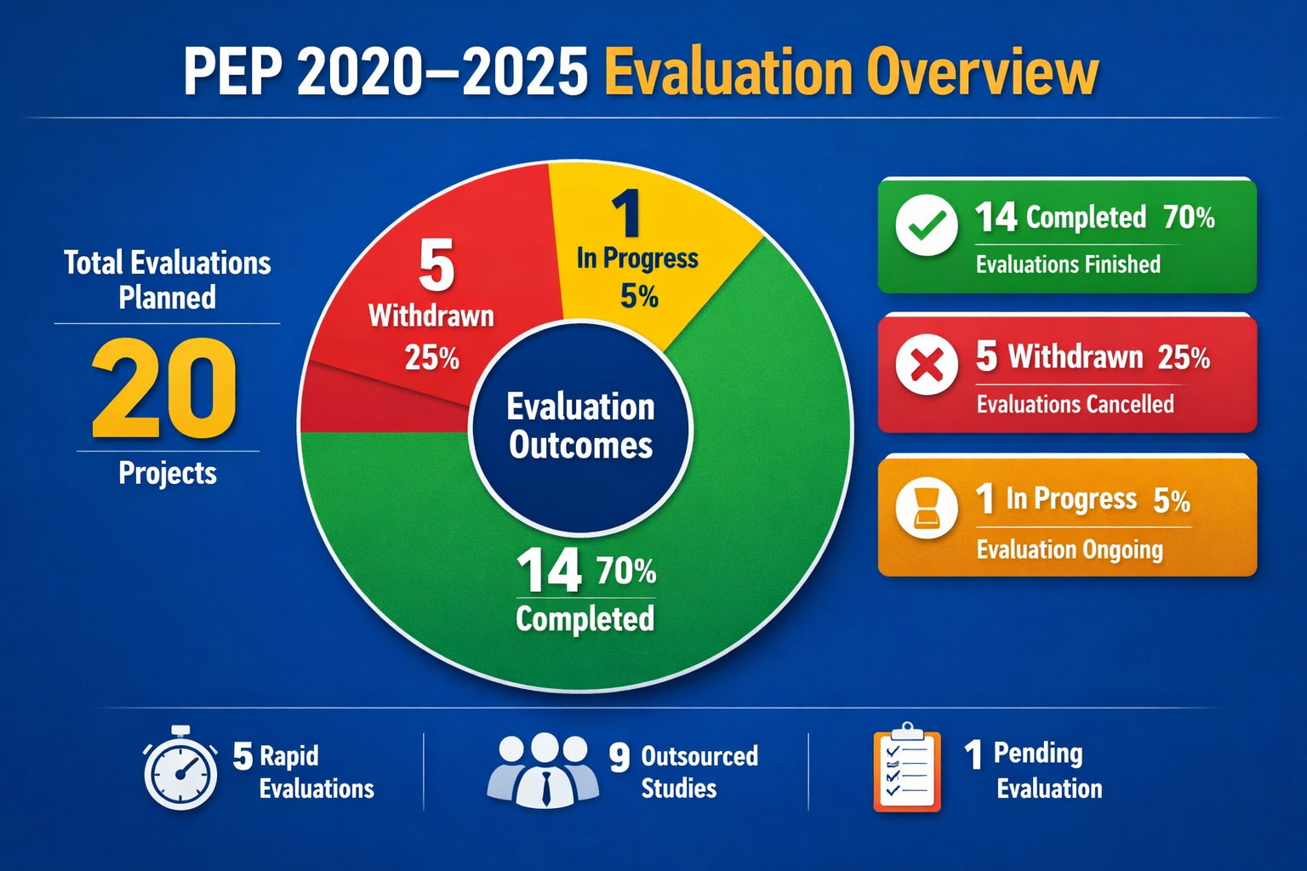
5. 2020-2025 PEP Review
PRESENTATION OUTLINE
Slide | 7

Slide 8
5.1 List all evaluations completed from 2020-2025 Period their status and the service providers
No. | Evaluation name and type | Year undertaken | Status of evaluation (Completed/ Ongoing | Presented to executive management structures (Yes/No) | Management response | Improvement Plan developed (Yes/no)
1. | Phezukomkhono Mlimi (Implementation and Outcome) | 2025/26 | Completed | Yes | Yes | Yes
2. | Upgrading of Informal Settlements Programme (Implementation and Outcome) | 2025/26 | Completed | Yes | No | No
3. | Tourism Safety Monitoring programme (Implementation and Outcome) | 2025/26 | Completed | No | No | No
4. | Louieville Road paving project (Implementation and Outcome) | 2025/26 | Completed | Yes | Yes | Yes
5. | Premier’s Youth Development Fund (Implementation and Outcome) | 2025/26 | Completed | Yes | Yes | Yes
6. | Oversight monitoring on policing programme (Implementation and Outcome) | 2025/26 | Ongoing | No | No | No
7. | Integrated Municipal Support Programme (Rapid Evaluation) | Rapid 2024/25 | Completed | Yes | Yes | Yes
8. | Transversal Term Contract (Rapid Evaluation) | Rapid 2024/25 | Completed | Yes | Yes | No
9. | Rapid implementation evaluation of Mdala nature reserve and Mkhombo dam nature reserve | Rapid 2024/25 | Completed | No | No | No
10. | Effectiveness of Governance structure in CHC facilities (Rapid Evaluation) | Rapid 2024/25 | Completed | Yes | Yes | Yes
11. | Sakh’abakhi contractor Development Programme (Rapid Evaluation) | Rapid 2024/25 | Completed | Yes | Yes | Yes
12. | Rural Boarding Schools (Implementation and Outcome) | 2023/24 | Completed | Yes | Yes | Yes
13. | Fortune 40 (Implementation and Outcome) | 2023/24 | Completed | Yes | Yes | Yes
14. | Household Initiatives for Sustainable Livelihoods Programme (Implementation and Outcome) | 2023/24 | Completed | Yes | Yes | Yes
15. | Dignity Sanitary Towels project (Implementation and Outcome) | 2023/24 | Completed | Yes | No | No

Slide 9
5.2. Withdrawn evaluations
Evaluation Topic | Department | Reasons for withdrawal
Provincial Anti –Corruption Strategy | Mpumalanga Provincial Government | Due to lack of clarity whether the strategy was approved and being implemented.
Zazi Campaign | Mpumalanga Provincial Government | This was a proposed implementation study; however, the programme had already closed. Rather, it was recommended for consideration in future for a summative than a formative study.
Ideal Status Health Facility Programme | DoH | Due to the fact that the implementation of the programme was assessed continually through the Frontline Monitoring and Support programme. The OTP felt it would result to duplication of monitoring and overcommitment of resources.
Skills/ Artisans development programme | DPWRT | Withdrawn on account of the programme custodian department, DPWRT.
Community Works Programme in the Province | DPWRT | Withdrawn because COGTA had already appointed a service provider to undertake the study.
PRESENTATION OUTLINE
Slide | 9

Slide 10
5.3. Methodology
Guided by NEPF standards and OECD-DAC Criteria
Assessment focused on
  Identifying challenges and barriers,
  Evaluation successes,
  Lessons learnt, and
  Actionable recommendations, as well as assessing
  Adequacy of Monitoring, Evaluation and Learning (MEL) structures supporting implementation.
Evaluation reports scored using a four-point scale (1-4)across key parameters:
  Relevance and alignment with NEPF, MTDP, and provincial priorities;
  Design and methodological rigor;
  Implementation and timeliness; and
  Quality of evaluation reports.
PRESENTATION OUTLINE
Slide | 10

Slide 11
5.4. Summary score for all 14 evaluations
 | Report Name | Relevance | Methodological Rigor | Timeliness | Report Quality | Stakeholder Participation & Ownership | Evidence-informed Decision-Making | Institutional Arrangements & Capacity | Sustainability & Lessons Learned
1 | Outcome Evaluation Study on the Integrated Municipal Support Programme (IMSP) | 4 – Strong alignment | 3 (Good) | 3 (Good) | 3 (Good) | 2 ( Fair) | 3 (Good) | 2 (Fair) | 3 (Good)
2 | Report on the Implementation Evaluation of Phezukomkhono Mlimi Programme | 4 – Strong alignment | 3 (Good) | 2 (Fair) | 3 (Good) | 3 (Good) | 3 (Good) | 2 (Fair) | 3 (Good)
3 | Report on the Evaluation of the Fortune 40 Mpumalanga Young Farmers’ Incubation Programme | 4 – Strong alignment | 3 (Good) | 3 (Good) | 3 (Good) | 3 (Good) | 3 (Good) | 2 (Fair) | 3 (Good)
4 | Mpumalanga Province Transversal Term Contract Rapid Evaluation report | 4 – Strong alignment | 3 (Good) | 3 (Good) | 3 (Good) | 3 (Good) | 1 | 2 (Fair) | 3 (Good)
5 | Rapid implementation evaluation of Mdala nature reserve and Mkhombo dam nature reserve | 4 – Strong alignment | 3 (Good) | 3 (Good) | 3 (Good) | 1 | 0 | 2 (Fair) | 3 (Good)
6 | Implementation and Outcome Evaluation of D233 Louisville Road Project | 4 – Strong alignment | 3 (Good) | 3 (Good) | 3 (Good | 3 (Good) | 3 (Good) | 2 (Fair) | 3 (Good)
7 | Report on the Rapid Evaluation of the Sakhabakhi emerging contractor development programme | 4 – Strong alignment | 3 (Good) | 3 (Good) | 3 (Good) | 3 (Good) | 3 (Fair) | 2 (Fair) | 3 (Good)
PRESENTATION OUTLINE
Slide | 11

Slide 12
5.5. Summary score for all 14 evaluations cont’
 | Report Name | Relevance | Methodological Rigor | Timeliness | Report Quality | Stakeholder Participation & Ownership | Evidence-informed Decision-Making | Institutional Arrangements & Capacity | Sustainability & Lessons Learned
8 | Report on the Evaluation of the Premier’s Youth Development Fund ( PYDF) | 4 – Strong alignment | 3 (Good) | 3 (Good) | 3 (Good) | 3 (Good) | 3 (Good) | 3 (Good) | 3 (Good)
9 | Report on the Rapid Evaluation of the Effectiveness of Governance Structures in Primary Health Care Facilities | 4 –Strong alignment | 3 (Good) | 2 (Fair) | 3 (Good) | 3 (Good) | 2 (Fair) | 2 (Fair) | 3 (Good)
10 | Report on the Evaluation of the Rural Boarding Schools project | 4- Strong alignment | 2 (Fair) | 2 (Fair) | 3 (Good) | 3 (Good) | 3 (Good) | 2 (Fair) | 3 (Good)
11 | Evaluation of the Sanitary Dignity Towels Project in Mpumalanga Province, South Africa. | 4 – Strong alignment | 2 (Fair) | 2 (Fair) | 3 (Good) | 3 (Good) | 1 | 2 (Fair) | 3 (Good)
12 | Evaluation of Informal Settlements Upgrade Programme: Mpumalanga Province 2019-2024 | 4- Strong alignment | 3 (Good) | 2 (Fair) | 3 (Good) | 2 (Good) | 2 (Fair) | 2 (Fair) | 3 (Good)
13 | Outcomes Evaluation of the Household Initiatives for Sustainable Livelihood Intervention by DSD in Mpumalanga | 4- Strong alignment | 3 (Good) | 2 (Fair) | 3 (Good) | 4--Strong ownership | 3 Good | 2 (Fair) | 3 (Good)
14 | Evaluation of the Mpumalanga Tourism Safety Monitoring Programme-Final Report | 4 – Strong alignment | 3 (Good) | 3 (Good) | 3 (Good) | 4 – Strong ownership | 0 | 2 (Fair) | 3 (Good)
 | Average Score | 4 | 3 | 2 | 3 | 3 | 2 | 2 | 3

Slide 13
6. Key findings
Strong policy alignment with SDGs, NDP 2030 and provincial priorities.
Evaluations consistently applied mixed-methods approaches guided by NEPF standards and OECD-DAC criteria.
Broad stakeholder participation during evaluation enriched credibility.
Reports transparent, triangulated evidence, and actionable recommendations.
Weaknesses: Poor MEL systems, and weak stakeholder involvement.
PRESENTATION OUTLINE
Slide | 13

Slide 14
7. Evaluation Success
Policy alignment with national and provincial priorities (education, health, poverty reduction, youth empowerment, infrastructure, tourism).
Broad stakeholder participation, enriching evidence and strengthening credibility
Credible results and/or findings and comprehensive reporting, applying OECD-DAC criteria and documenting successes and failures transparently.
Capacity building, particularly through rapid evaluations, which transferred skills to provincial staff and emerging evaluators.
Evidence uptake in health and education sectors, where findings informed strategies and improved collaboration with civil society.
PRESENTATION OUTLINE
Slide | 14

Slide 15
8. Evaluation Challenges
Absence of Theory of Change at programme inception, weakening causal analysis.
Lack of baseline data, constraining measurement of change and attribution.
Weak MEL systems and poor indicator setting across departments which resulted in disaggregated data.
Coordination and ownership challenges, including withdrawal of partners and weak municipal-level involvement.
Resource constraints, such as budget cuts, limited staff, and inadequate infrastructure.
Community mistrust and poor cooperation from institutions (e.g., SAPS, MTPA) in some evaluations.
PRESENTATION OUTLINE
Slide | 15

Slide 16
9. Lessons learnt
Theory of Change at inception is critical for clarity and rigor.
Baseline data integration must be non-negotiable to enable credible measurement of outcomes.
Institutional MEL culture is essential; weak systems undermine evaluation quality.
Stakeholder engagement enhances ownership and credibility; weak buy-in reduces legitimacy.
Balance between rapid and outsourced evaluations is needed: rapid for urgent insights, outsourced for comprehensive learning.
Institutional uptake of recommendations remains limited; stronger mechanisms are required.
Sustainability planning depends on fiscal commitment, political will, and institutional ownership
PRESENTATION OUTLINE
Slide | 16

Slide 17
10. Recommendations for 2026-2030 PEP
Institutionalize evaluation frameworks (ToC, baseline, MEL upfront)
Strengthen MEL systems with training & digital tools
Enhance stakeholder ownership via formal structures
Balance rapid (diagnostic) vs outsourced (comprehensive) evaluations
Ensure systematic uptake of recommendations into budgeting & policy
Secure fiscal & political commitment
Promote knowledge sharing platforms
PRESENTATION OUTLINE
Slide | 17

Slide 18
11. Conclusion
The 2020–2025 PEP provided credible, relevant evaluations
Lessons learnt will strengthen the 2026–2030 cycle
The 2020–2025 PEP advanced evidence-based governance in Mpumalanga.
Successes in alignment, participation, and capacity building.
Challenges in methodology, data, and institutional culture.
Lessons provide a foundation for a stronger, more strategic 2026–2030 plan.
PRESENTATION OUTLINE
Slide | 18

Slide 19

THANK YOU
THANK YOU
DANKIE
REA LEBOHA
HI NKHENSILE
SIYATHOKOZA SIYABONGA
NDO LIVHUWA
ENKOSI

